Slide 1
Scottish Household Survey Analysis Factors influencing Neighbourhood Ratings and Community Belonging
Emma Menzies

Slide 2
Scottish Household Survey
Annual cross-sectional survey of random people in private residences across Scotland
In 2019 10,577 householders agreed to take part
Running since 1999
Redesigned in 2011 and 2020
Aims to provide policy relevant data and be useful to stakeholders

Slide 3
Definitions
Neighbourhood rating: "THINKING NOW ABOUT THE NEIGHBOURHOOD YOU LIVE IN, HOW WOULD YOU RATE IT AS A PLACE TO LIVE? If pressed, define 'your neighbourhood' as: 'the street you live in and the streets nearby' (urban) or 'the local area' (rural).”
(1) Very good (2) Fairly good (3) Fairly poor (4) Very poor No opinion
Community belonging: "HOW STRONGLY DO YOU FEEL YOU BELONG TO YOUR IMMEDIATE NEIGHBOURHOOD?“
(1) Very strongly (2) Fairly strongly (3) Not very strongly (4) Not at all strongly Don't know
SIMD quintile: Scottish Index of Multiple Deprivation. This categorises 6,976 small areas of Scotland based on income, employment, education, health, access to services, crime, and housing.
Social rented: Managed by public authorities and housing associations with support from the Scottish Government.

Slide 4
Key Questions
Does access to greenspace increase neighbourhood ratings and/or community belonging?
Which areas have the best and worst ratings? Does this correlate with certain factors?
What other factors influence neighbourhood ratings and community belonging?

Slide 5
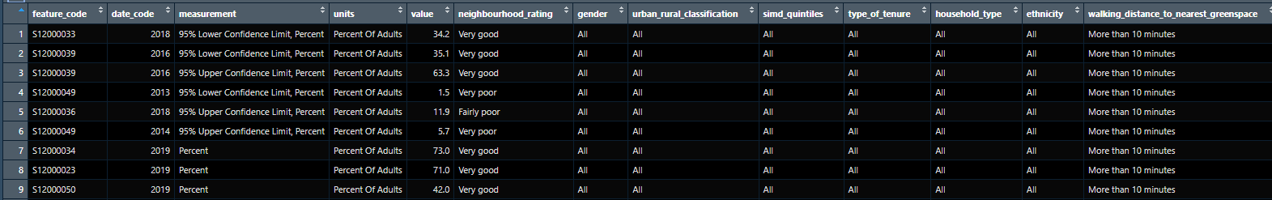
Data Cleaning
Row 9: 42% of adults in a particular area in 2019 with a walking distance of more than 10 minutes to their nearest greenspace rated their neighbourhood “Very good”.
STEPS
Join council area names based on feature code
Factor the neighbourhood ratings
Create a column to calculate a score for each row based on the rating and value

Slide 6
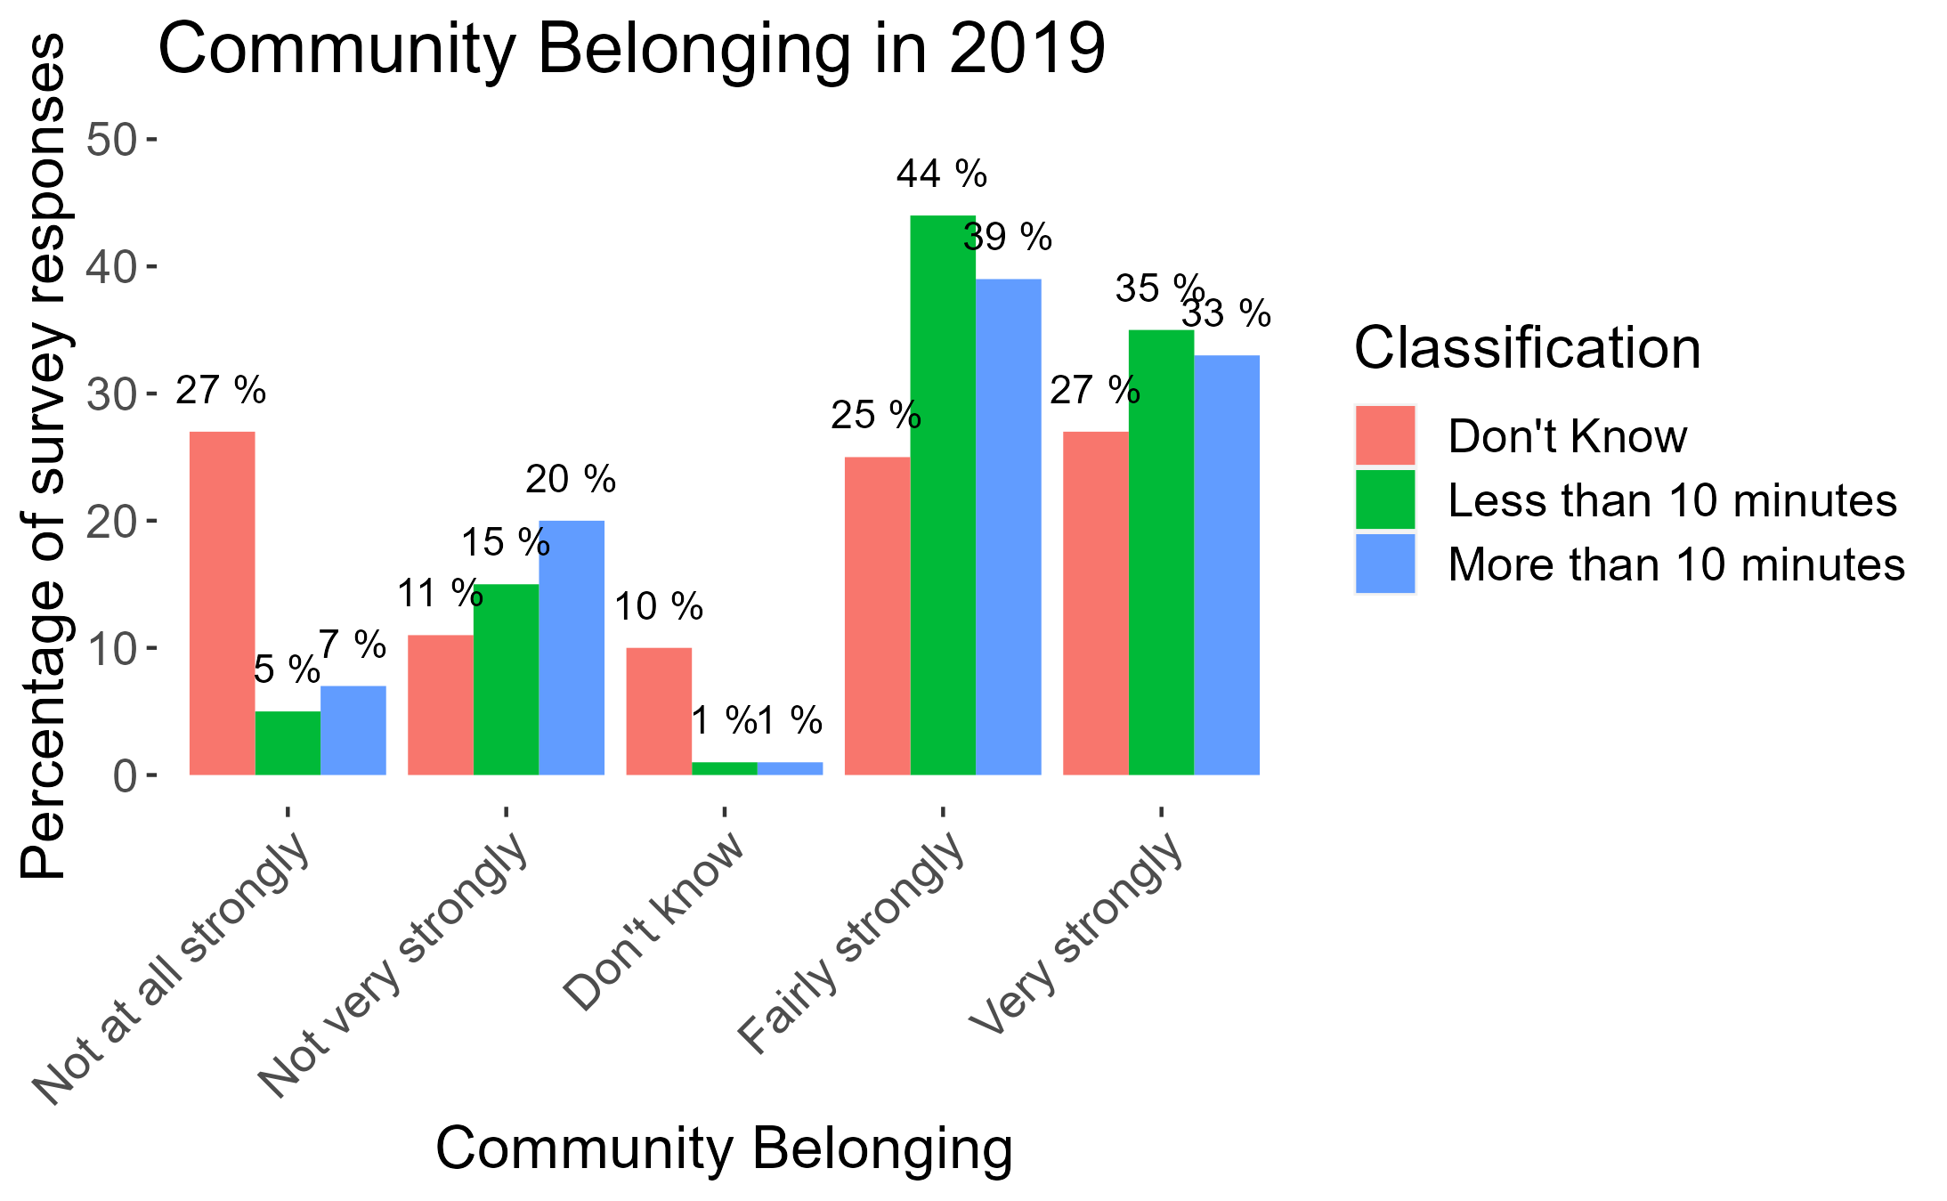
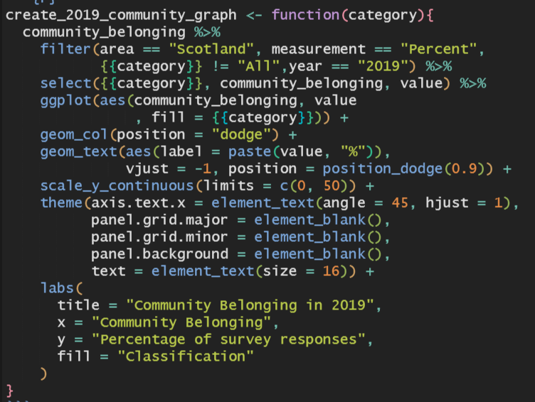
Does Access to Greenspace Impact Community Belonging?
Walking distance to nearest greenspace
Function to create visualisations

Slide 7
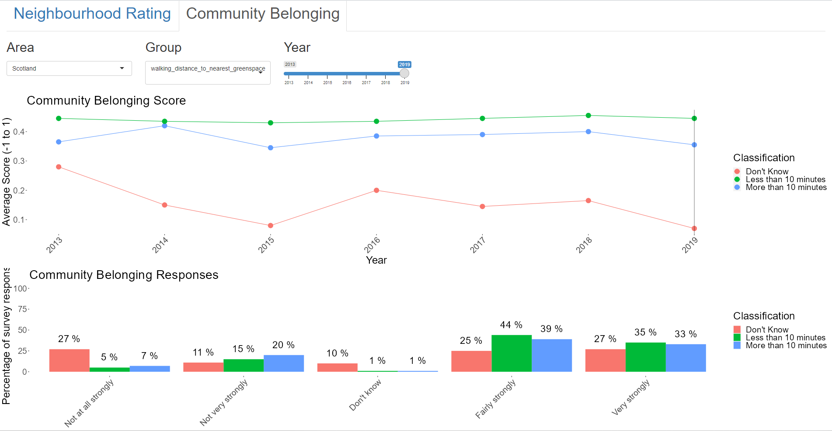
R Shiny App

Slide 8
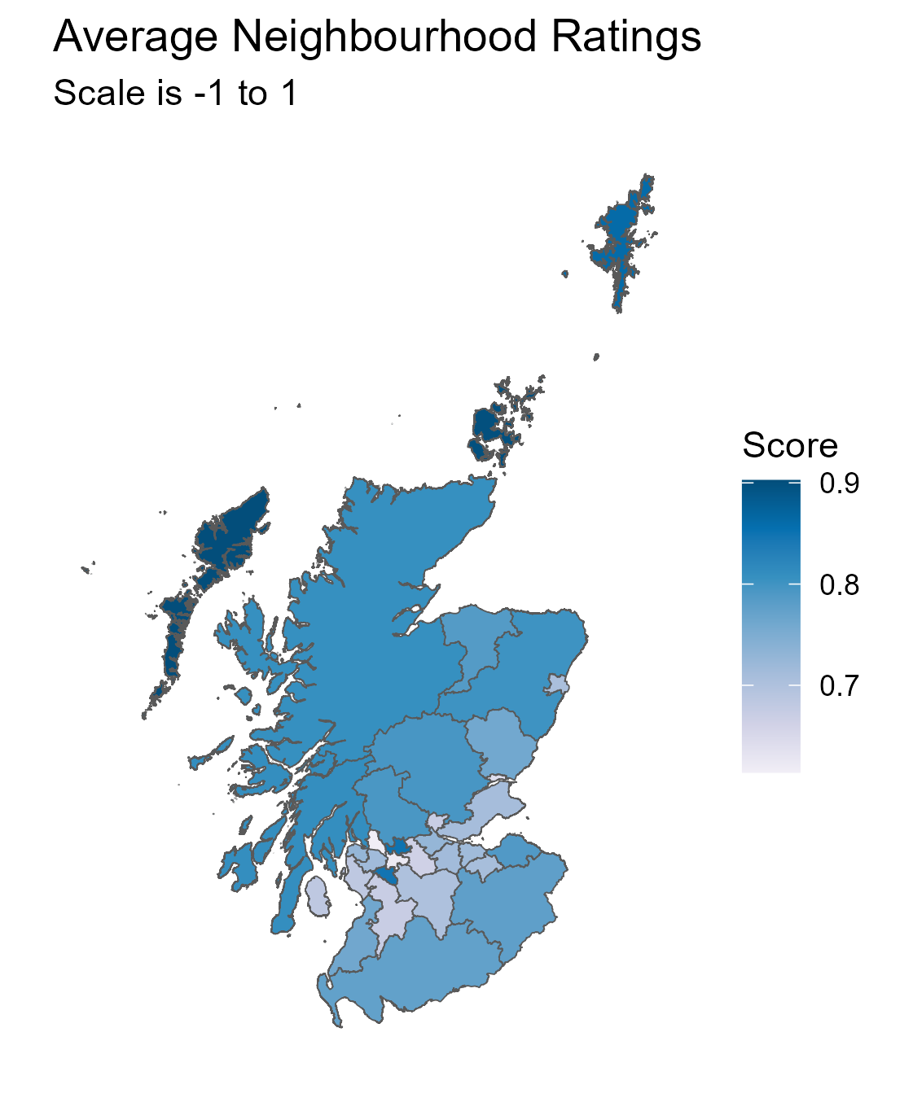
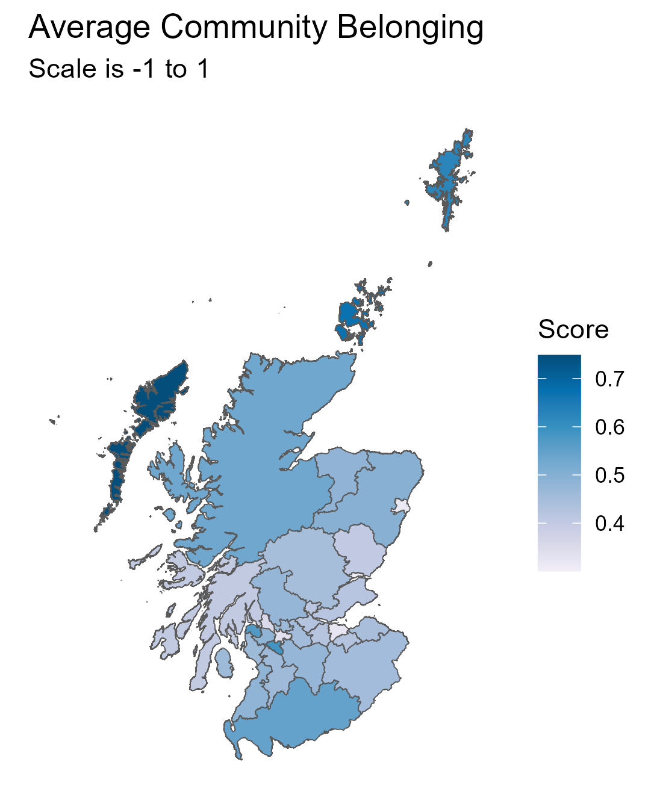
Differences Across Scotland
Changes from 2013 - 2019
Top Rated Areas | Neighbourhood | Community
Outer Hebrides
Orkney Islands
Shetland Islands
East Renfrewshire
Highland
+4%
+5%
-8%
-9%
-2%
-0%
-0%
-16%
-4%
-5%
Bottom Rated Areas | Neighbourhood | Community
Dundee City
Aberdeen City
Glasgow City
West Dunbartonshire
Clackmannanshire
+4%
+23%*
-3%
-19%*
+0%
-5%
-10%*
+0%
+6%
+13%
* Biggest magnitude of change across Scotland

Slide 9
Key Factors Influencing Neighbourhood Ratings and Community Belonging
Highest Ratings
Pensioners
Access to greenspace less than 10 minute walk
80% least deprived
White
Home owners
Rural areas
Lowest Ratings
Pensioners
Access to greenspace less than 10 minute walk
80% least deprived
White
Home owners
Rural areas

Slide 10
Action

Slide 11
Further Ideas

Slide 12
Reflection

